Slide 1
Single-Cell RNA-Seq Analysis of Microglia in Alzheimer’s Disease
Ifthekar Hussain Computational Analysis Task

Slide 2
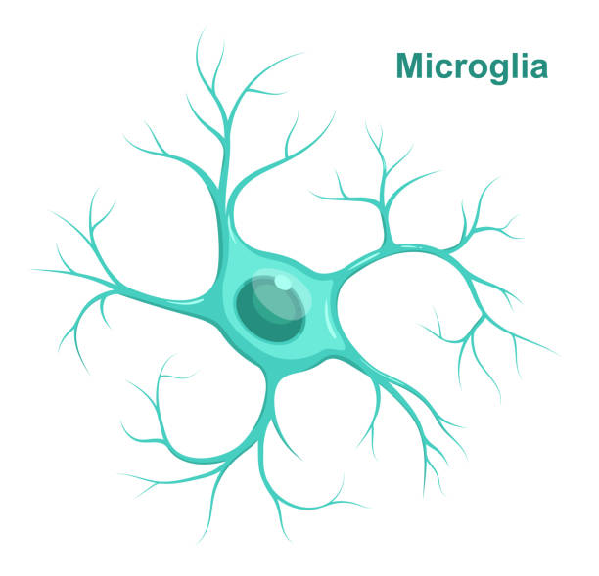
Study Objectives
Identify microglial gene expression changes across disease groups:
NND → nAD → iAD
Compare:
NND (healthy) vs nAD (Alzheimer’s)
nAD vs iAD (immunized Alzheimer’s)
Identify key microglial genes that are significantly up- or down-regulated
Perform GO Biological Process enrichment to link genes to pathways and functions

Slide 3
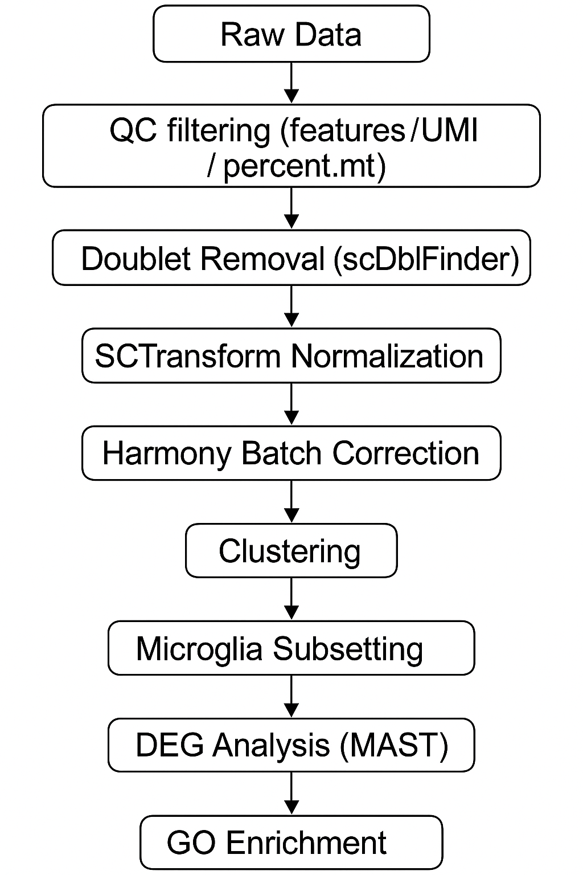
Dataset & Study Design
Dataset:
GSE263034, scRNA-seq
25 samples
Donors: NND = 6, nAD = 6, iAD= 13
Analysis Workflow

Slide 4
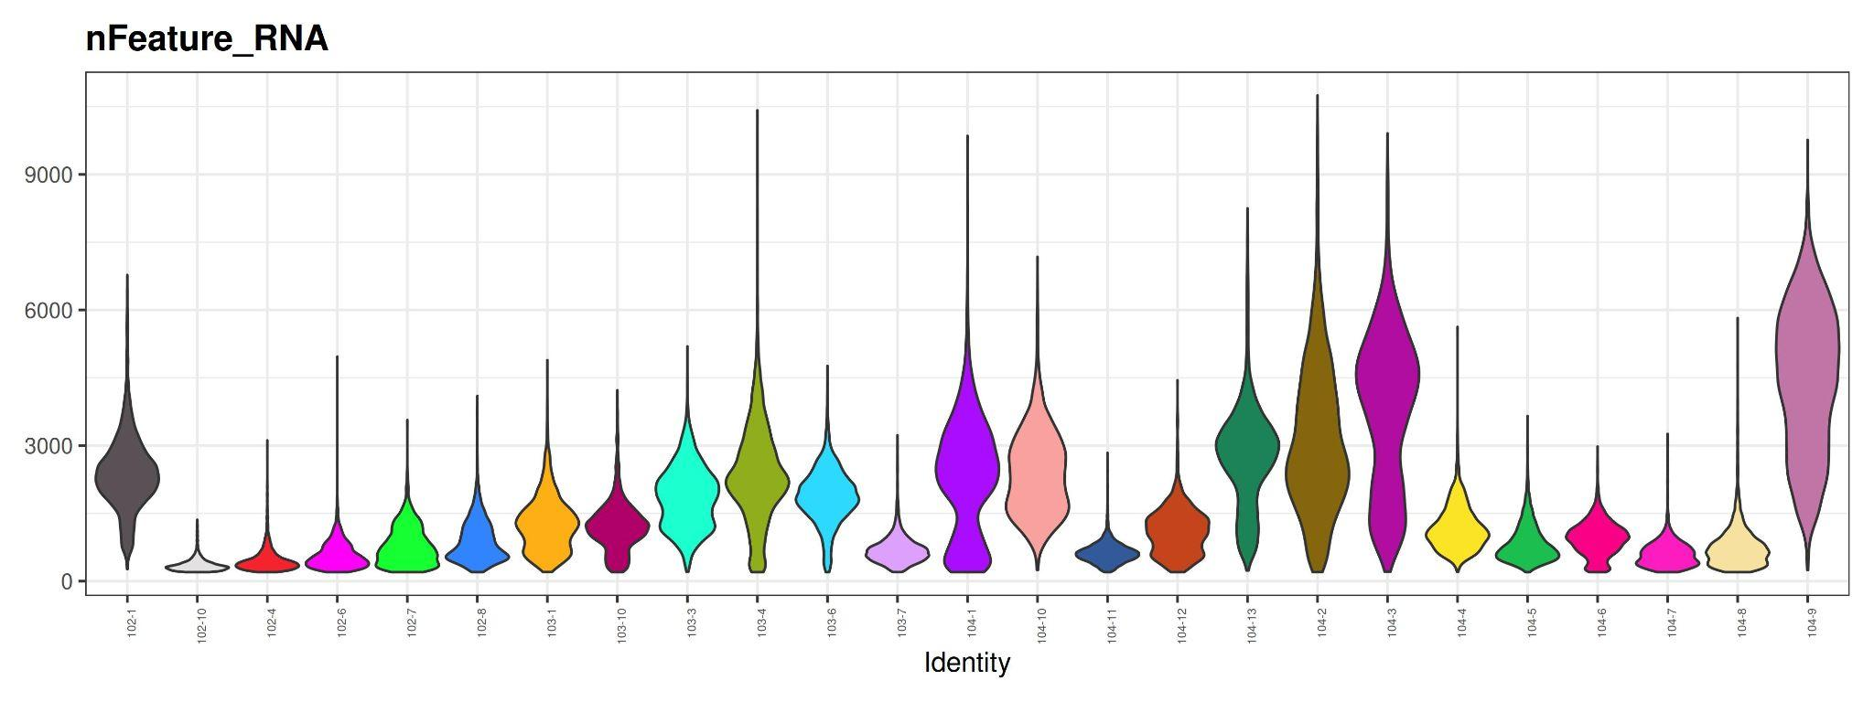
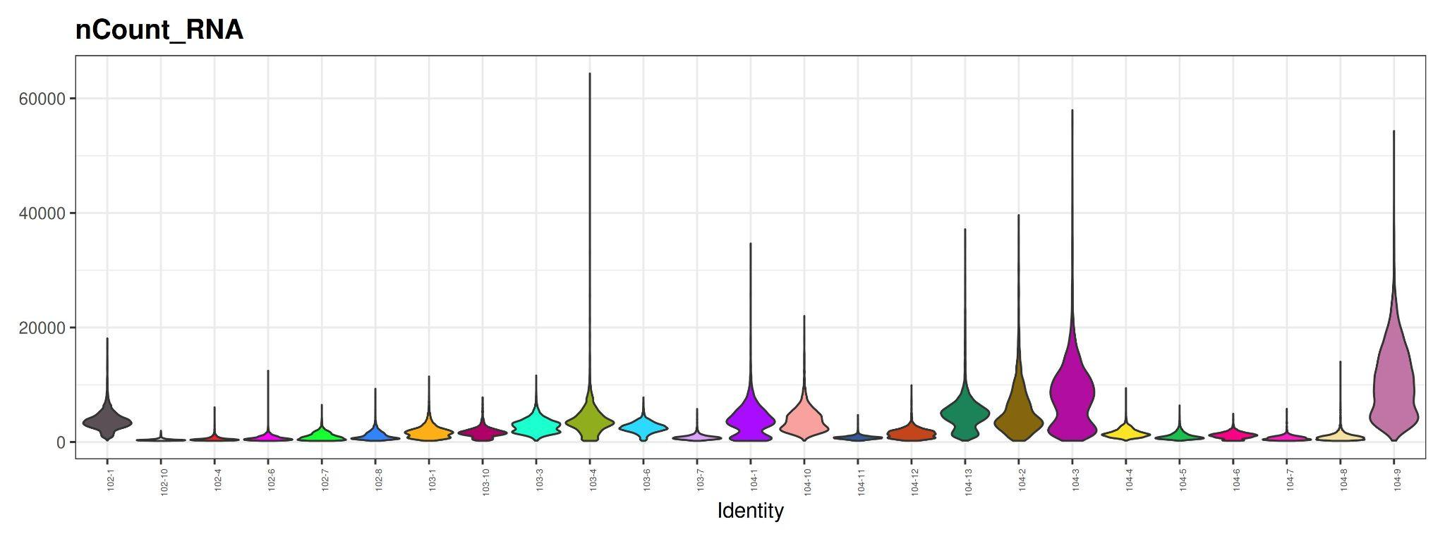
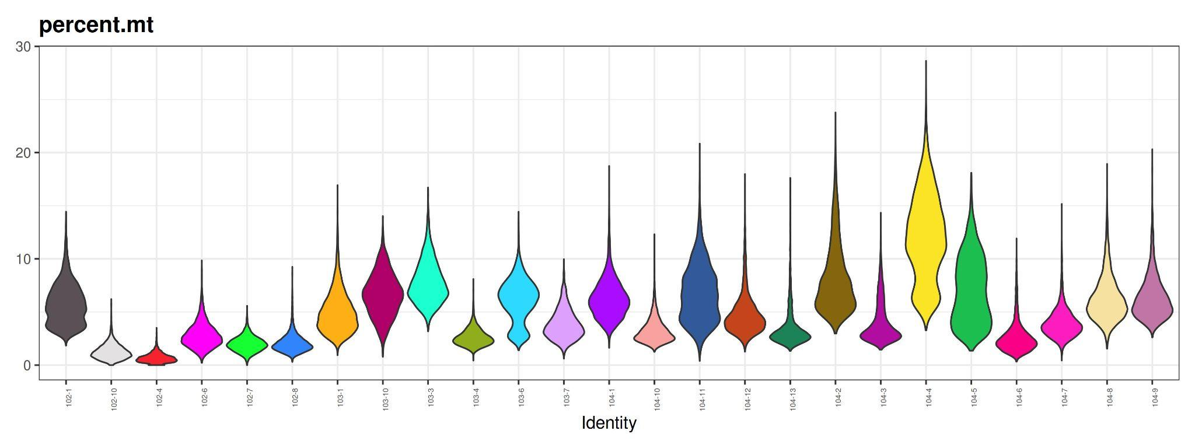
Quality Control ( Before Filtering)
Dataset contains variable cell quality
Outliers with:
Very low features
Very low UMIs
High mitochondrial percentage
Applied QC thresholds to remove low-quality
Notes:
In the nFeature_RNA plot, some samples show cells with extremely low gene counts, which indicates poor-quality or dying cells.
In the nCount_RNA plot, we again see a long tail of high counts in some samples, suggesting potential doublets.
In the dataset, several samples contained cells with >20% mitochondrial reads, which typically indicates stressed, dying, or low-quality cells, so these were removed during QC filtering.

Slide 5
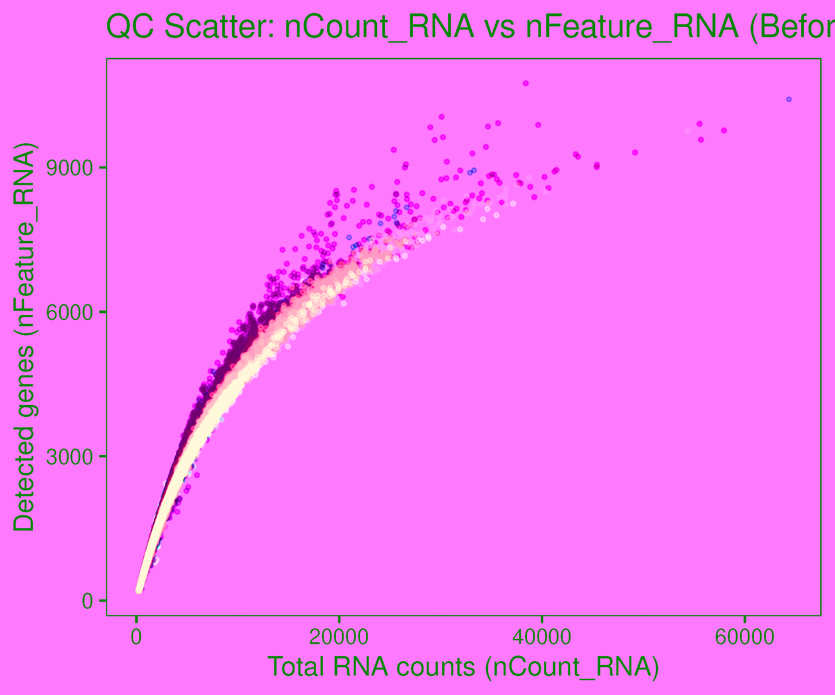
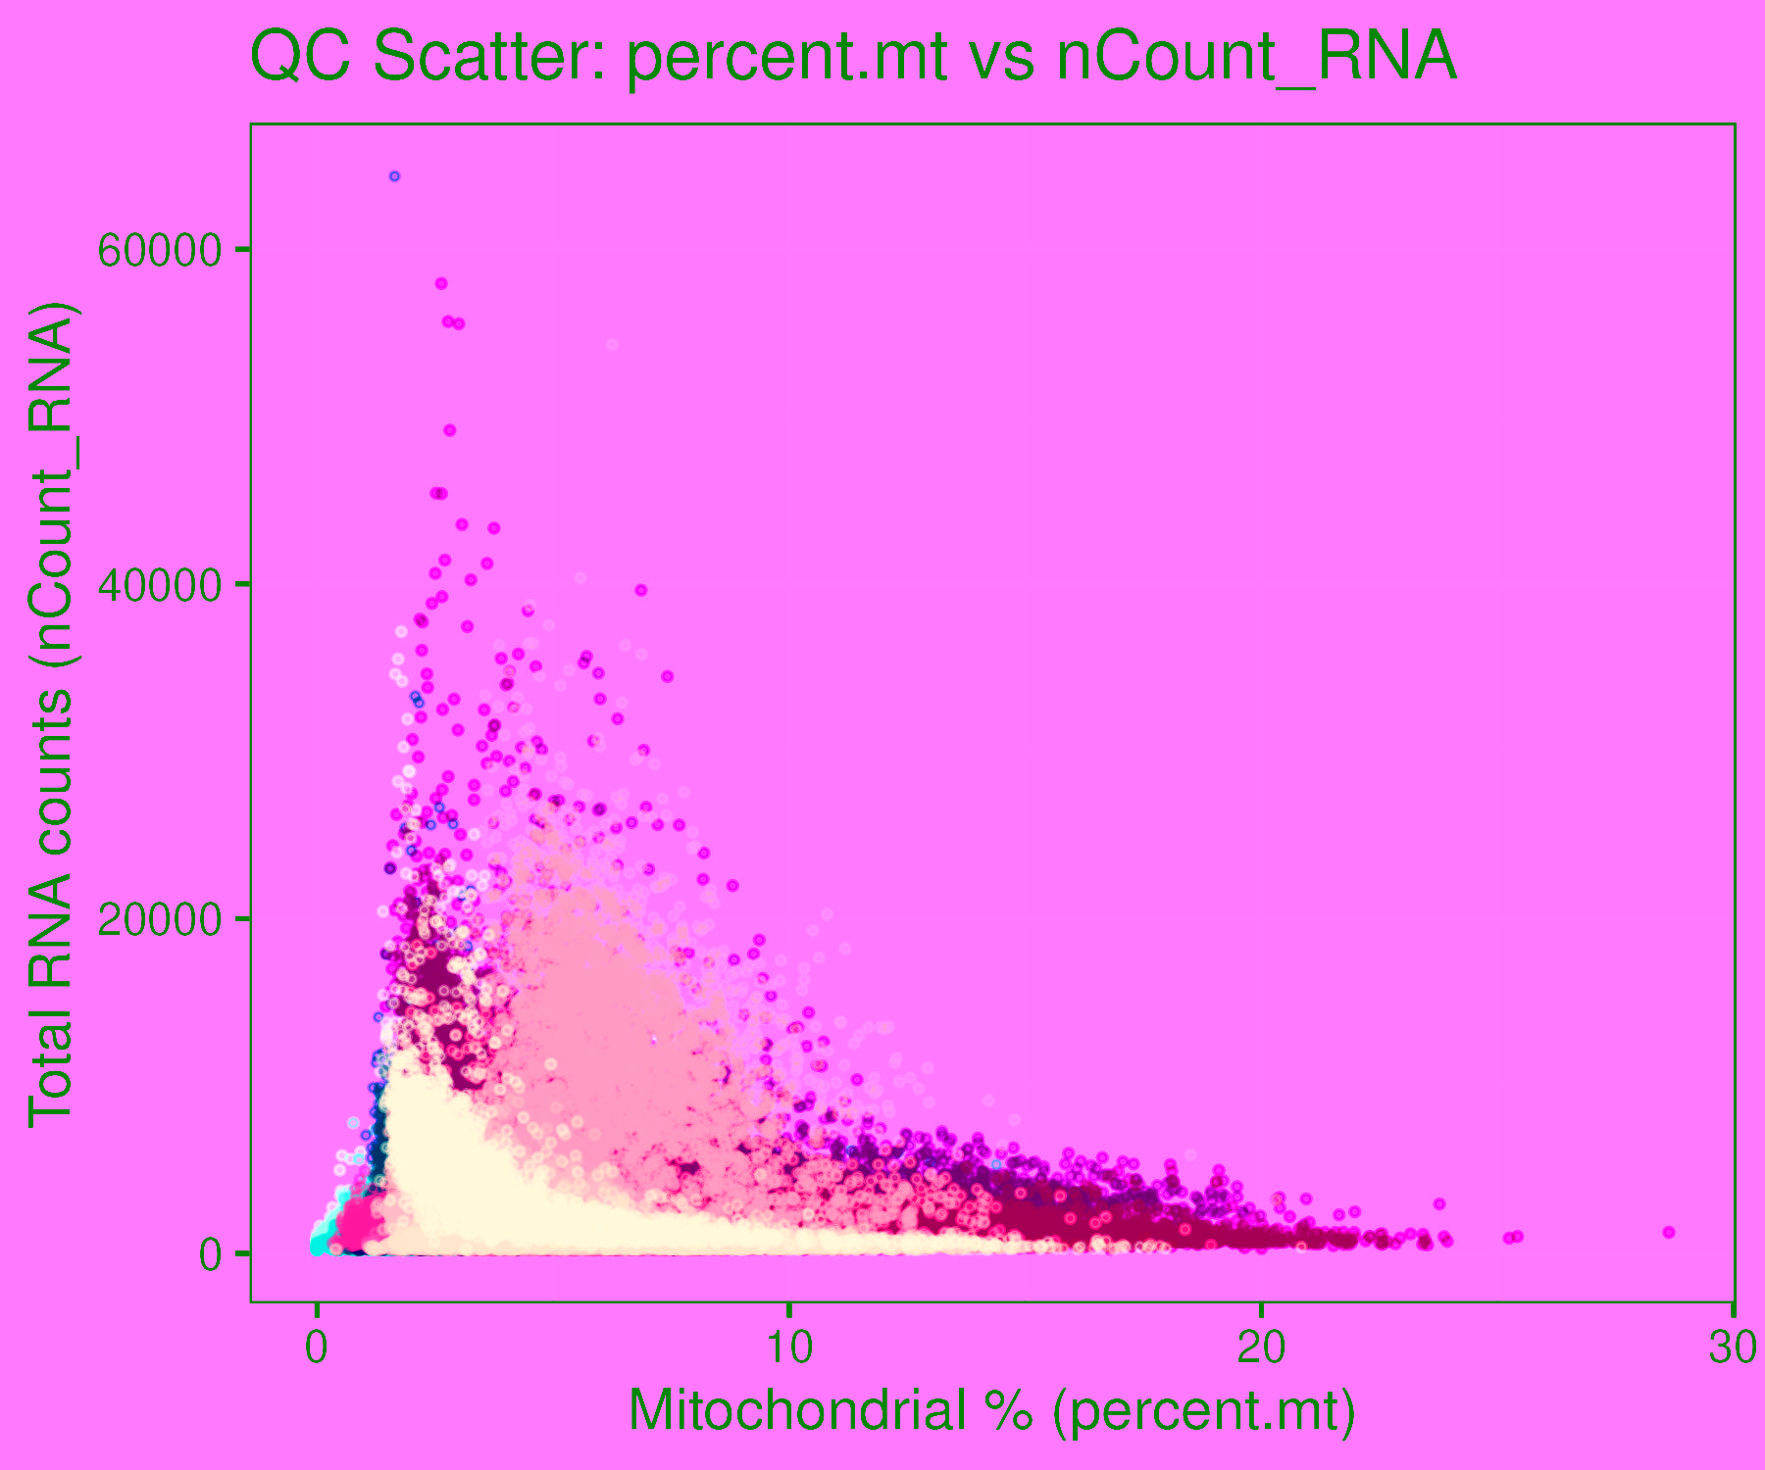
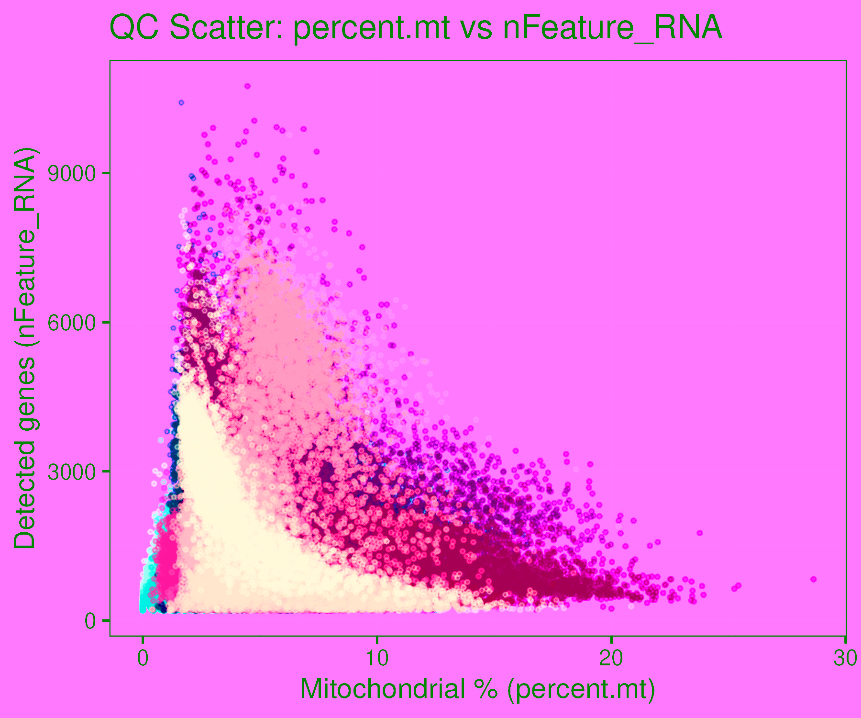
.
Notes:
nCount vs nFeature: In this plot, I’m checking whether each cell has a healthy transcriptome. Good cells follow this smooth increasing curve, high UMIs, high gene complexity. The scattered low-feature cells underneath the curve are classic low-quality droplets, so this helped me define my lower gene/UMI thresholds.
percent.mt vs nCount:
Here I’m looking for stressed or dying cells. Cells with high mitochondrial percent but low RNA complexity cluster on the left side. That pattern is exactly where mitochondrial leakage shows up biologically, so this plot guided my percent.mt cutoff.
percent.mt vs nFeature:
This plot is just a double-check. Good cells have low mitochondrial % and lots of genes. If a cell has high mito levels and very few genes, it usually means the cell is unhealthy, so I removed those to keep only good-quality microglia.

Slide 6
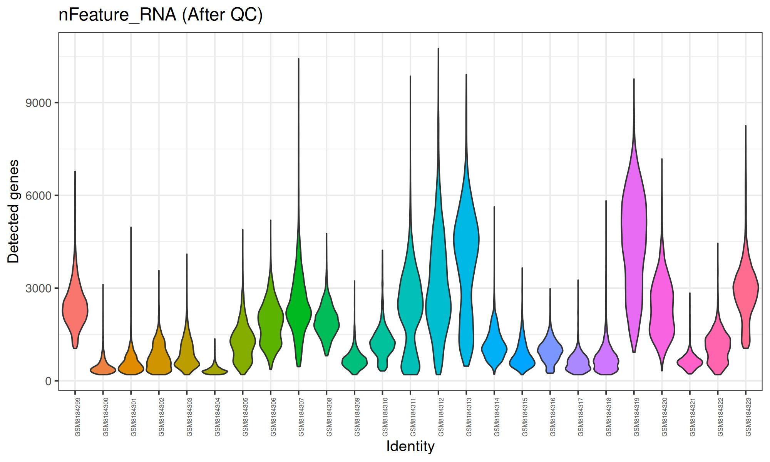
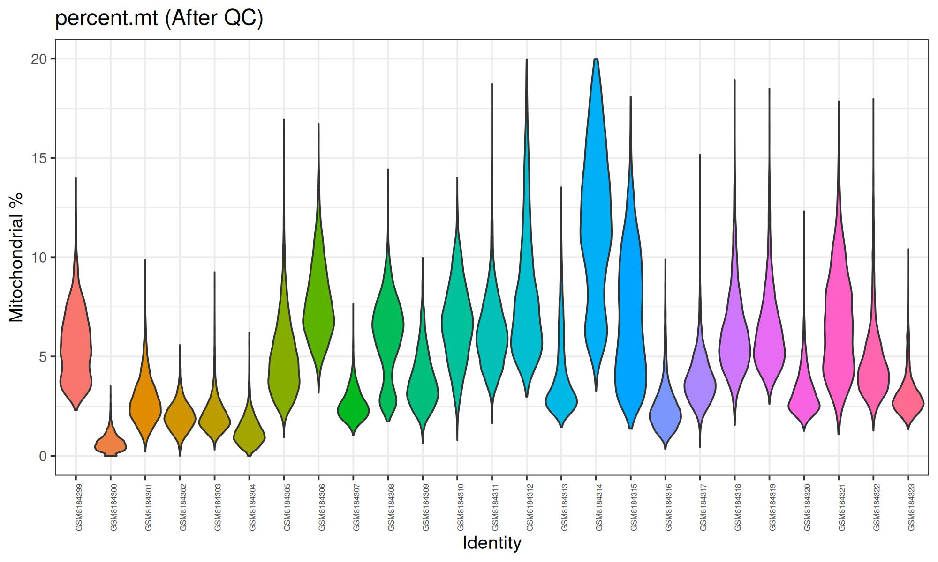
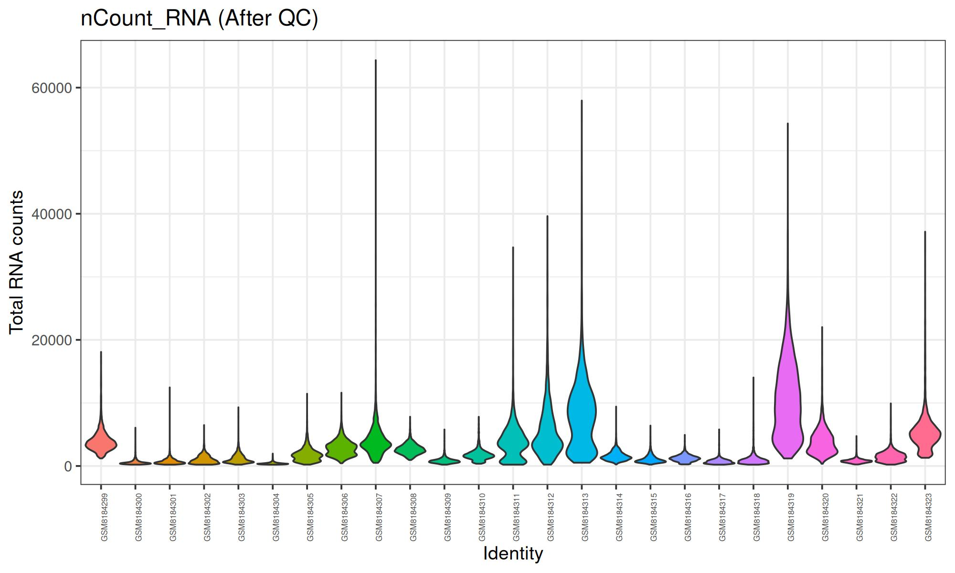
Quality Control(After Filtering)
Removed cells with extremely low RNA content
nCount_RNA < (median − 3 × MAD) per-sample threshold
nFeature_RNA < (median − 2 × MAD) per-sample threshold
Removed high-mitochondrial cells
percent.mt > 20%
Removed doublets
Detected using scDblFinder
Filtered separately for each sample
Notes:
I filtered cells using per-sample MAD thresholds for RNA counts and gene counts, removed any cells with mitochondrial % > 20%, and removed doublets with scDblFinder.

Slide 7
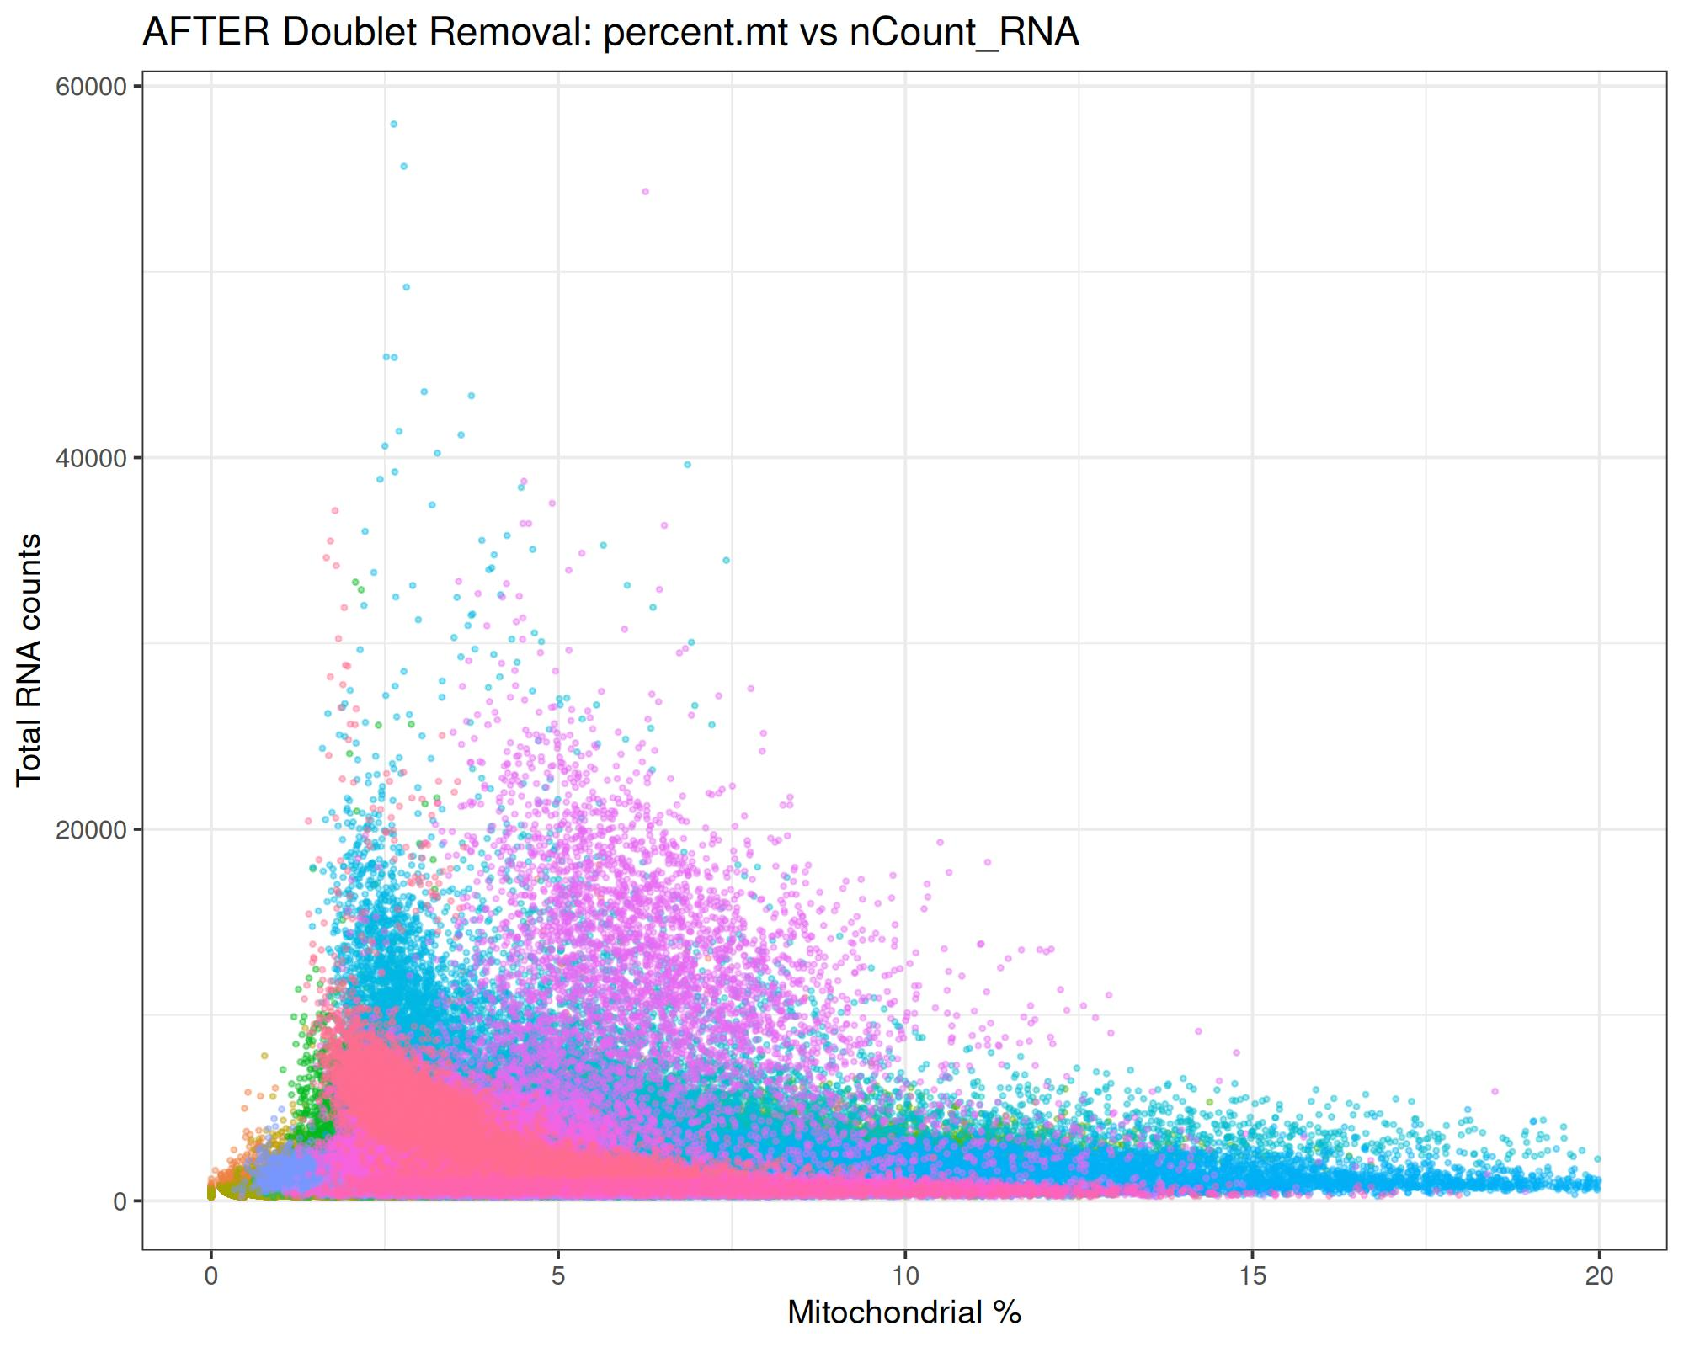
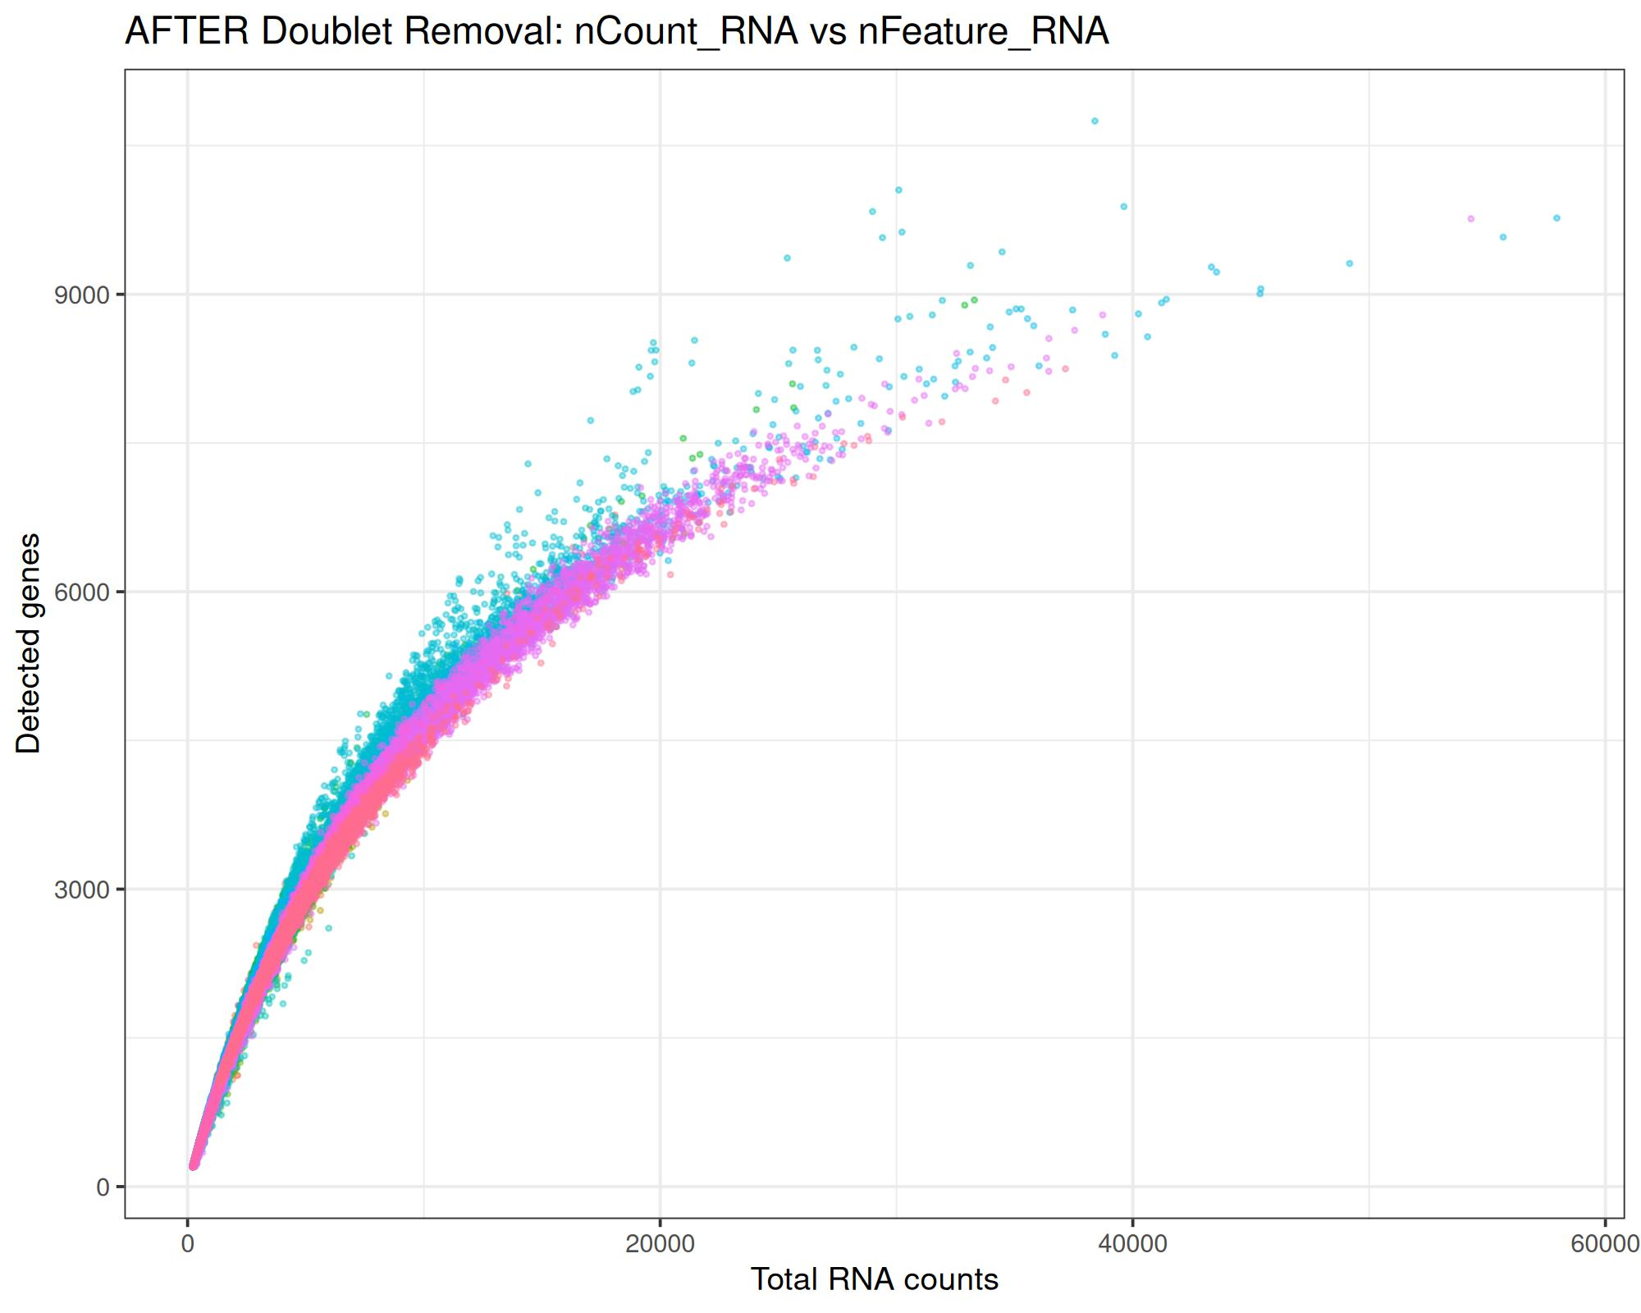
Doublet Detection
Doublets identified using scDblFinder (sample - wise detection)
Total cells after QC filtering : 112,196
Total cells after doublet removal: 106,298
Doublets removed: 5,898 cells
Final retention: 94.7% singlets
Notes:
After QC, I ran doublet detection with scDblFinder on all 25 samples.
I removed all predicted doublets and kept only high-confidence singlets.
The dataset went from 112,196 cells down to 106,298, so about 5,898 doublets were filtered out.

Slide 8
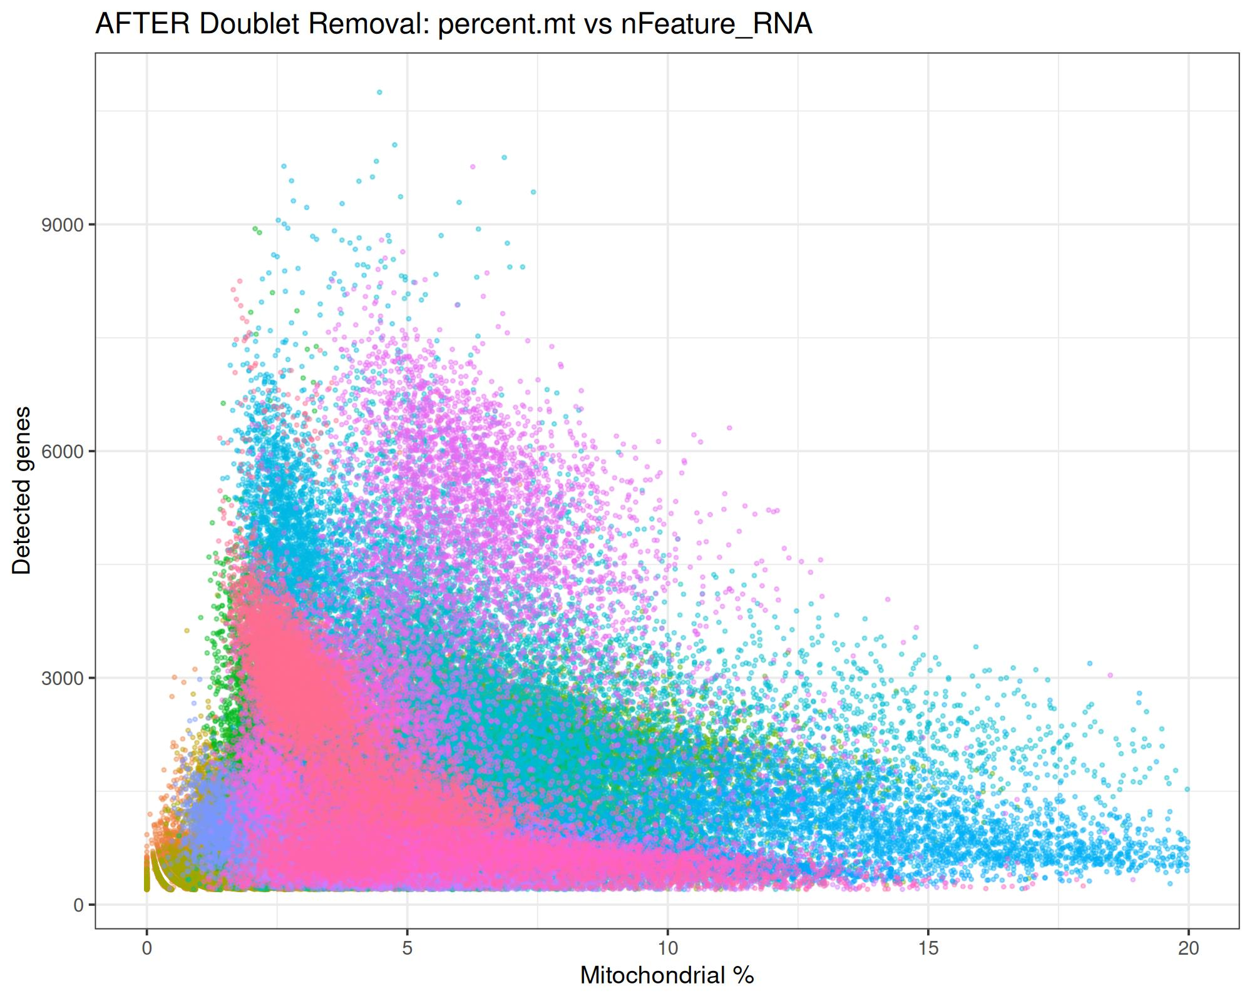
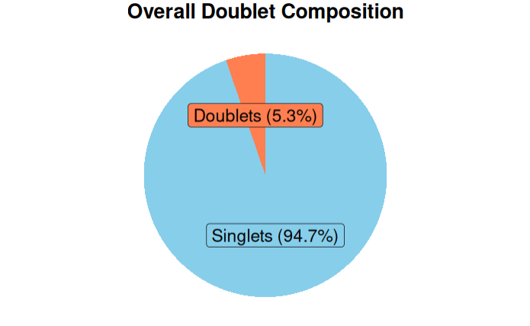
.
Notes:
The scatter plots and the pie chart clearly show the improvement after removal.
This step ensures that only true single cells move forward, preventing false clusters later.

Slide 9
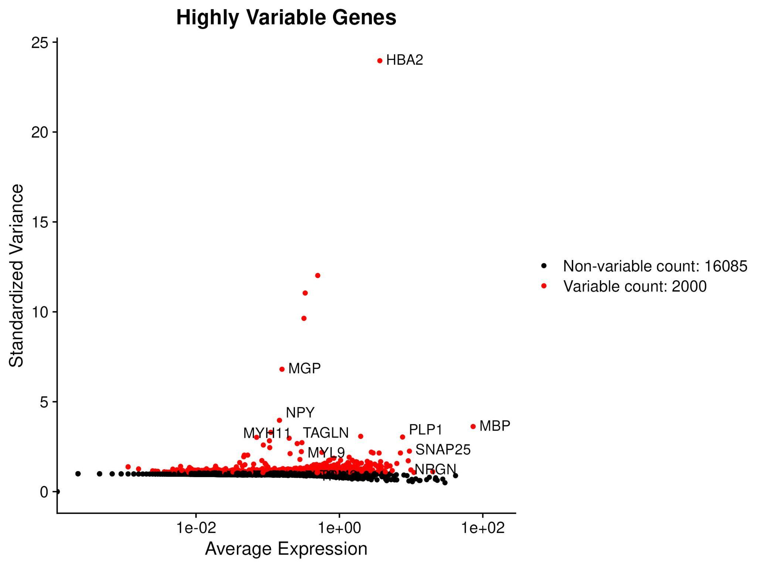
Normalization(SCTransform)
Normalized all 25 samples using SCTransform
Regressed mitochondrial percentage(percent.mt)
Removed technical noise and stabilized variance
Result: 106,298 high-quality cells ready for integration
Notes:
This highly variable gene plot is included as a quick quality check after normalization, It confirms that the dataset contains genes with meaningful biological variation and that the variance patterns look appropriate.
SCTransform internally selects its own variable genes for downstream steps, but this plot helps verify that the variability structure of the data is consistent and suitable for integration.

Slide 10
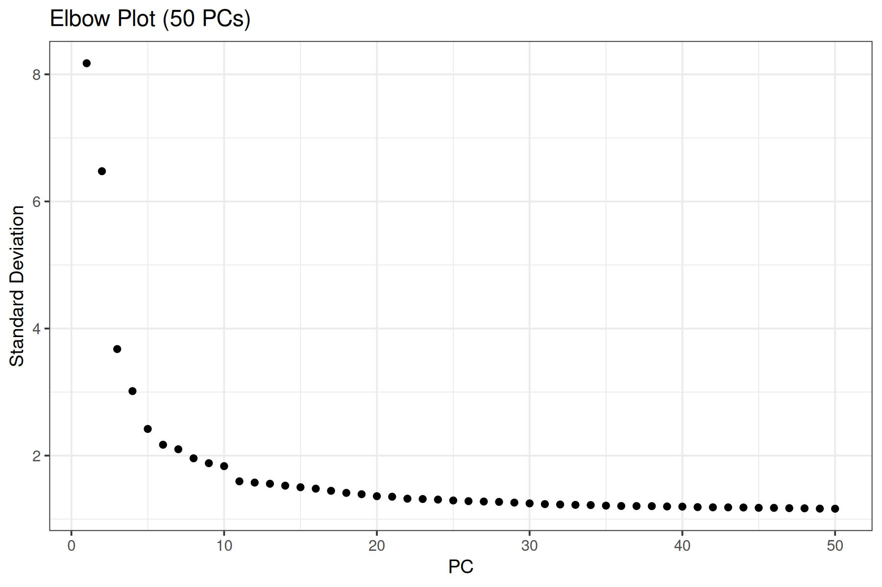
Batch Correction(Harmony Integration)
Combined all 25 SCTransformed samples for integration
Performed PCA to capture major variance components
Selected 30 PCs based on the elbow plot
Applied Harmony to correct donor specific batch effects
Samples align well after correction while preserving true biology
Selected 30PCs
Notes:
In this step, I combined all 25 normalized samples and ran PCA to summarize the major sources of variation, Based on the elbow plot, I selected around 30 principal components. These PCs were then used with Harmony to remove donor-specific batch effects while keeping the true biology intact.

Slide 11
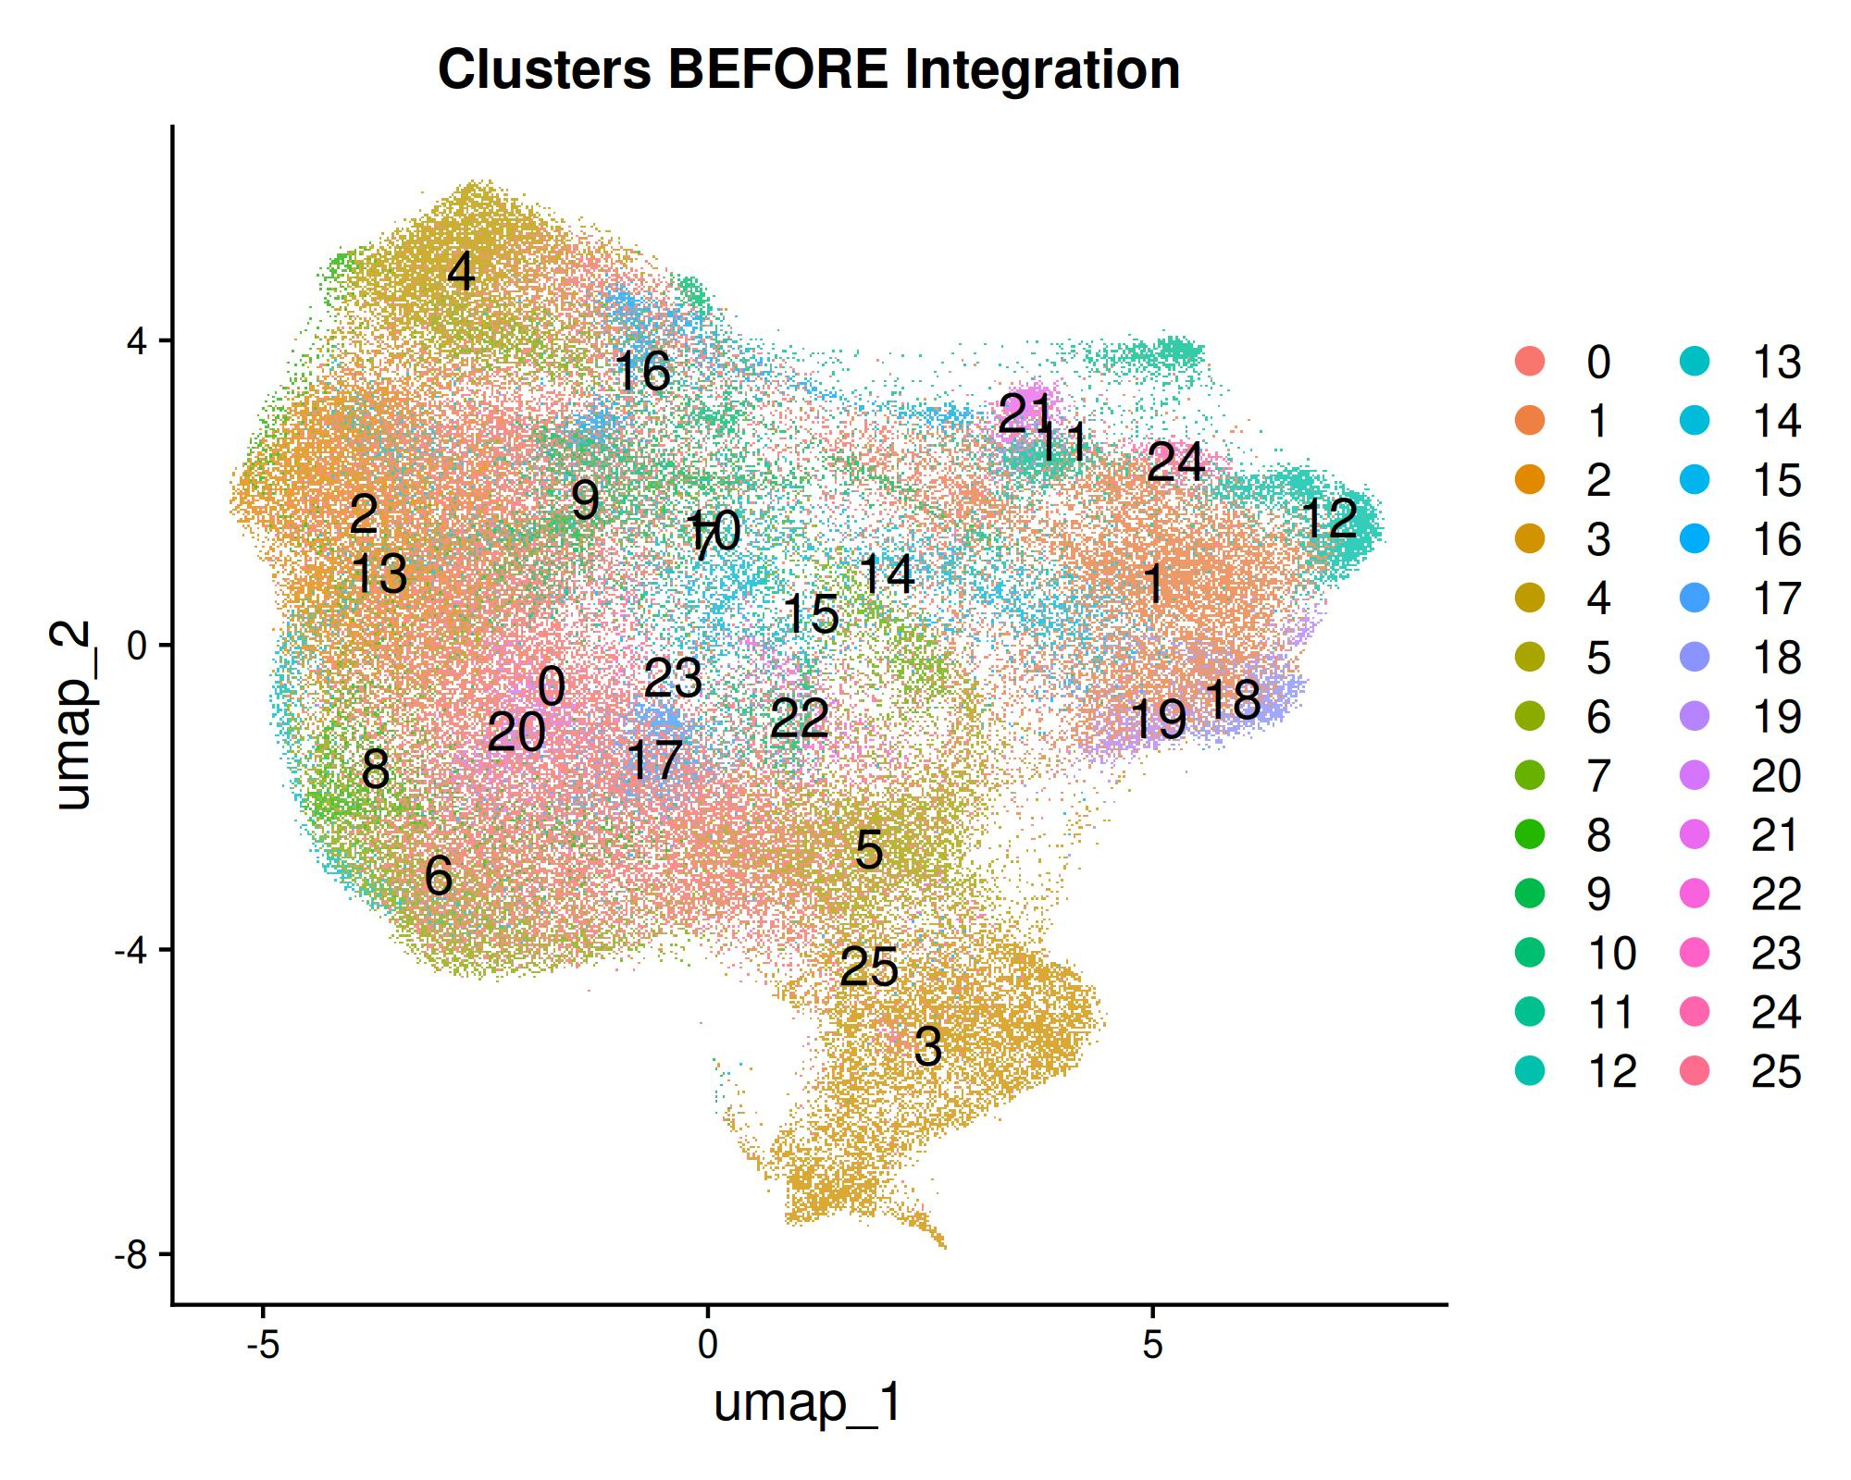
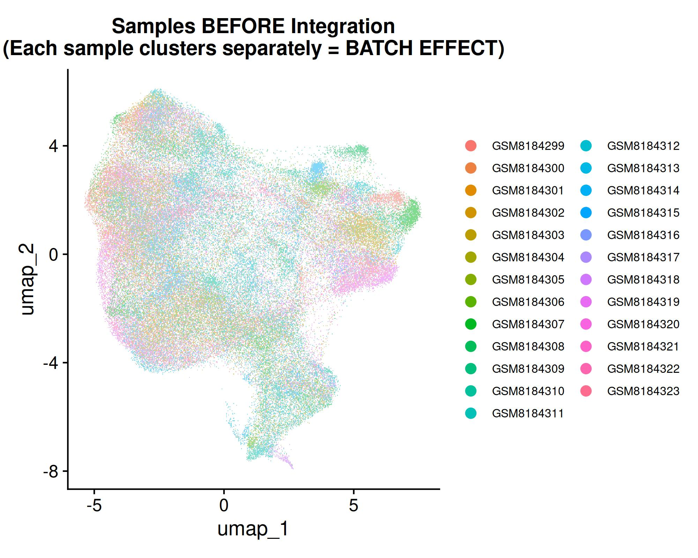
Before Integration (Batch Effects)
UMAP shows strong batch effects before integration
Samples cluster by donor, not biology
Technical variation dominates the structure, hiding true biology
Confirms the need for batch correction (Harmony)
Notes:
In this slide, I’m showing the data before integration.
You can see that the UMAP is mainly driven by batch effects. The structure is not organized by biology instead, the cells cluster according to which sample or donor they came from, This tells us that technical variation is dominating the dataset. These patterns confirm that batch correction is necessary, and that we need an integration method like Harmony to align the samples and remove donor-specific effects while keeping the real biological signals.

Slide 12
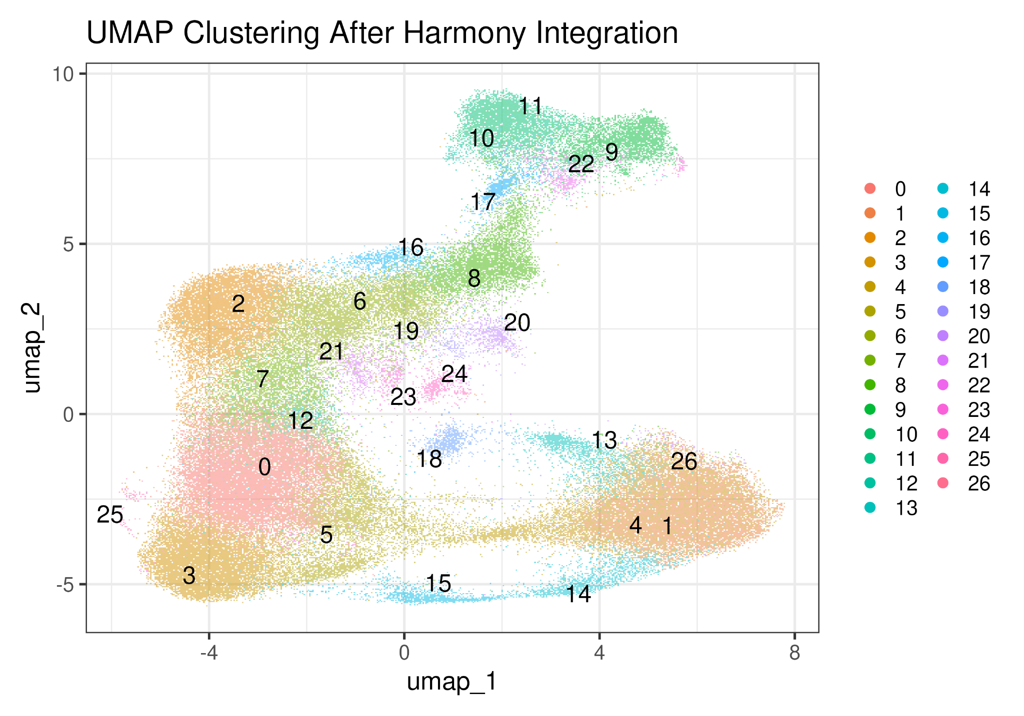
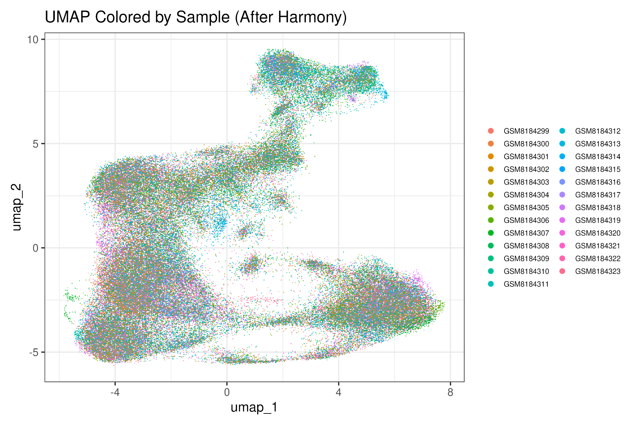
After Integration(Harmony Corrected)
Harmony successfully removed donor-specific batch effects
Samples from all donors now overlap instead of forming separate clusters
Technical variation is greatly reduced
UMAP structure is cleaner and more biologically meaningful
Clustering becomes more stable after correction
Notes:
Harmony removed the donor-specific batch effects, so samples now mix instead of clustering by donor.
The UMAP after integration shows cleaner and more meaningful clusters, driven by biology rather than technical noise.

Slide 13
Cluster Marker Identification (FindAllMarkers)
Identified top marker genes for each cluster using SCT-normalized data
Applied standard cutoffs: log2FC > 0.25 and min.25% expression
Extracted top 10 genes per cluster
Marker profiles used for biological interpretation
Basis for accurate cell-type annotation

Slide 14
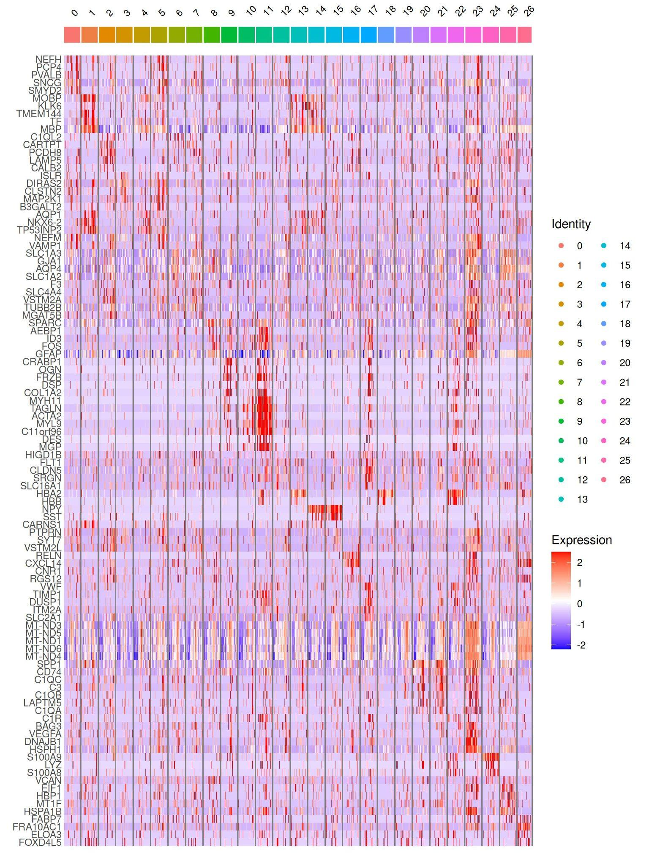
Marker Gene Heatmap

Slide 15
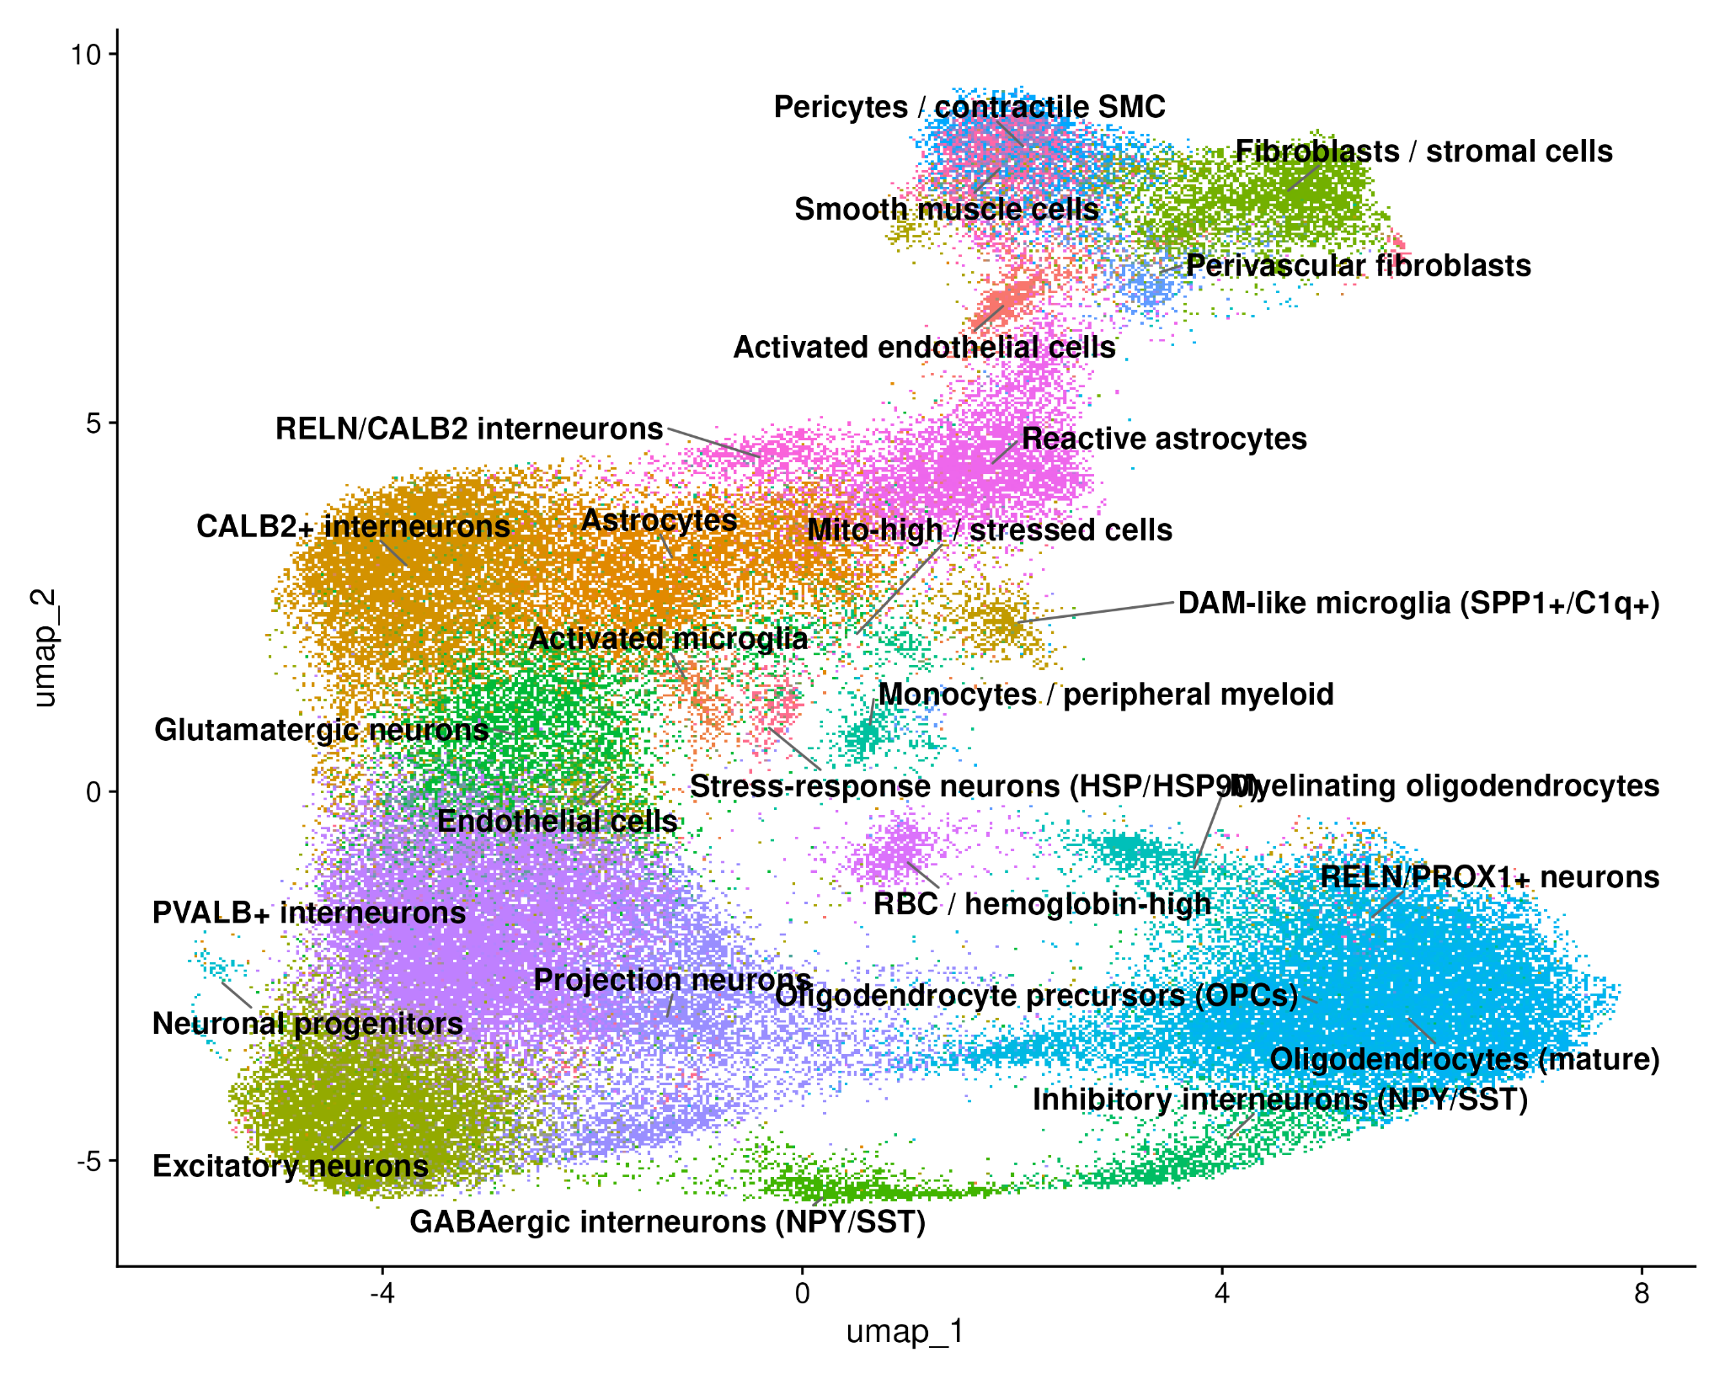
Cluster Annotation(cell-type identification)
Identified top marker genes for each cluster
Compared marker profiles with established cell-type signatures
Assigned biological labels to clusters based on marker expression patterns
Added final labels to metadata and visualized on UMAP
Microglia clusters
Notes:
For each cluster, I identified the top marker genes and compared them with known cell-type signatures from the literature. Based on those expression patterns, I assigned accurate biological labels to all clusters.
This UMAP shows the final annotated cell types, and here you can clearly see the microglial populations highlighted.

Slide 16
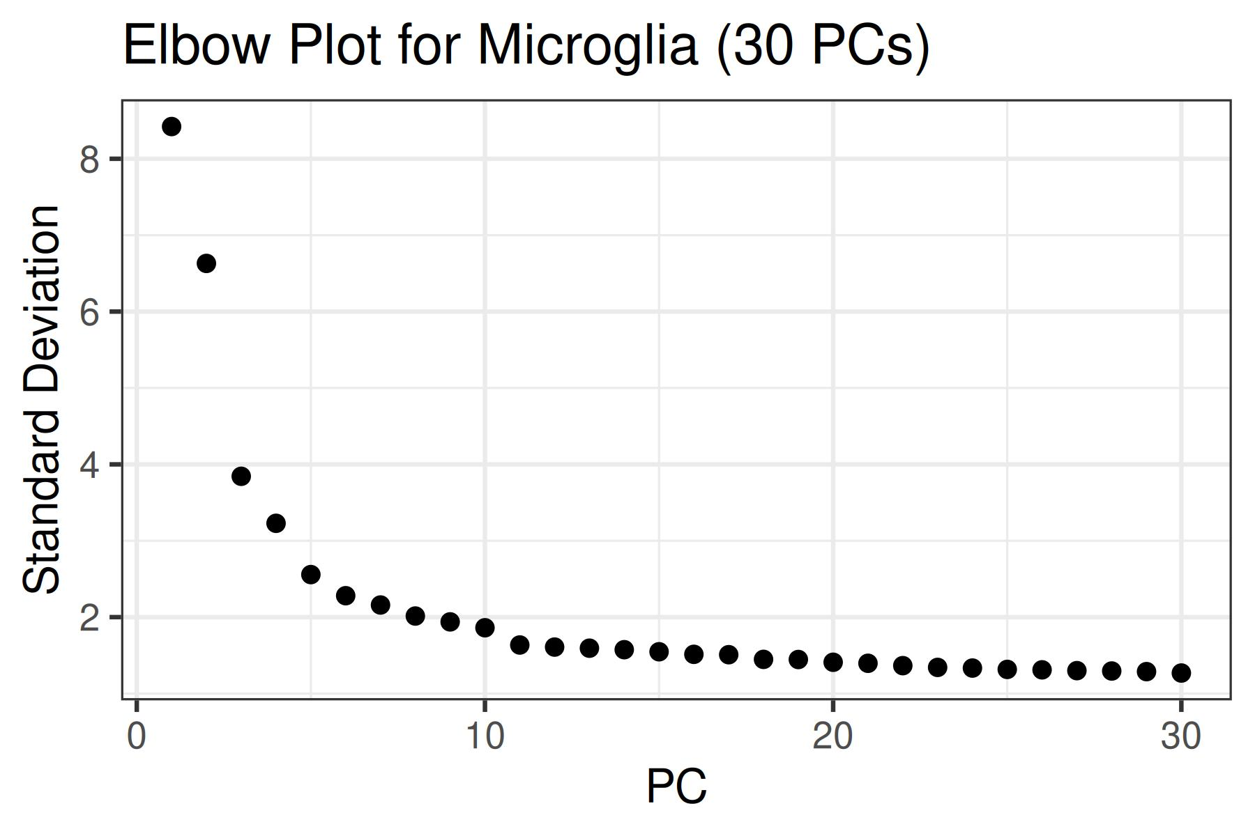
Microglia Subsetting & Re-clustering
Extracted microglia by selecting clusters 20, 21 & 23 from the Harmony-integrated UMAP
Confirmed microglia identity using average expression of canonical markers
Subset contained 2,133 microglial cells
Re-processed microglia subset using:
Log Normalize
FindVariableFeatures
ScaleData
PCA
Re-clustered microglia subset
PC15 = Inflection point
Notes:
We first identified microglia by selecting clusters 20, 21, and 23 from the Harmony-integrated UMAP. These clusters showed strong expression of canonical microglia markers such as TMEM119, CX3CR1, P2RY12, and TREM2, which we confirmed using AverageExpression. This gave us a final subset of about 2,133 microglial cells.
For reclustering, we re-processed this subset using the standard RNA workflow - LogNormalize, FindVariableFeatures, ScaleData, and PCA. From the elbow plot, the variance clearly stabilizes around PC15, which represents the inflection point. So, we used the first 15 PCs for microglia reclustering to capture biological signal.

Slide 17
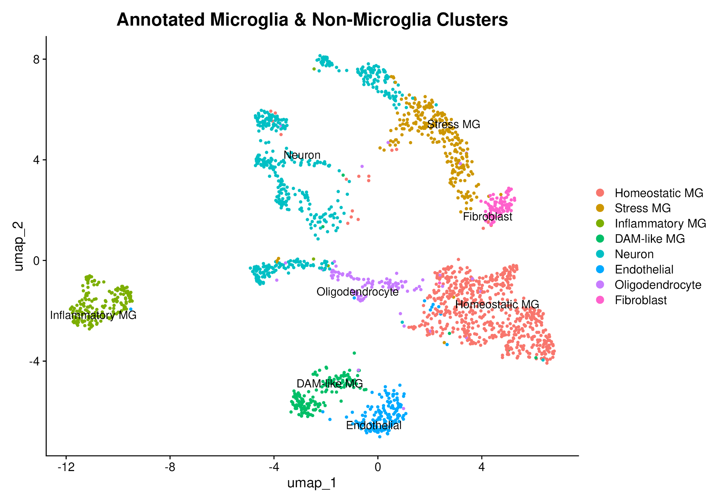
Microglia Reclustering & Marker Based Cell Type Annotation
Re-clustered microglia subset using 15 PCs and resolution = 0.3
Identified top markers with FindAllMarkers
Annotated clusters using canonical marker genes
Final UMAP shows clear separation of microglial states
Notes:
I annotated the clusters by running FindAllMarkers and matching the top markers for each cluster to known microglial signatures from the literature.
I identified homeostatic markers like TMEM119, P2RY12, CX3CR1; inflammatory markers like S100A8/A9 and LYZ; and DAM-associated markers like APOE, TREM2, and TYROBP.
These represent distinct microglial activation states, so UMAP separates them based on differences in transcriptional programs rather than simple spatial distance.

Slide 18
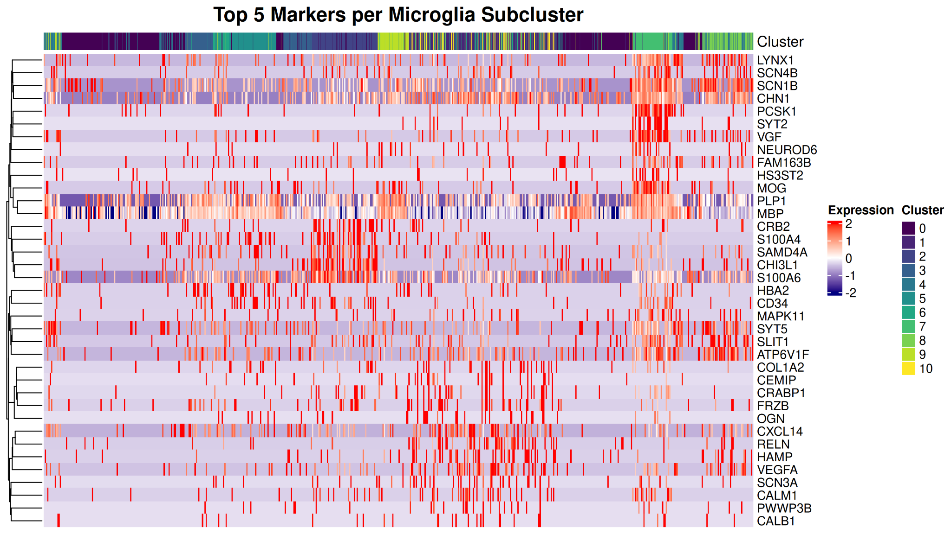
.
Notes:
This heat map shows the top 5 marker genes for each microglial subcluster.
I included it to validate the biological identity of the clusters.
You can see that each cluster has its own distinct expression signature the red bands highlight genes that are strongly upregulated in one cluster compared to others.
This confirms that the clusters I annotated homeostatic, inflammatory, DAM-like, stress microglia, and non-microglial contaminants are supported by their canonical marker expression patterns.
So the heatmap provides the biological justification behind the UMAP labels.

Slide 19
Differential Expression Analysis(MAST) on Microglia
Subsetted microglial states only (Homeostatic, Stress, Inflammatory, DAM-like MG)
Performed differential expression using MAST (single-cell hurdle model)
Two comparisons:
nAD vs NND
iAD vs nAD
Adjusted p-values using Benjamini–Hochberg (FDR < 0.05)
Extracted top up- and down-regulated genes for each comparison
Visualized significant genes using volcano plots (log2FC > 0.585, FDR < 0.05) to show up-regulated, down-regulated, and non-significant genes
Notes:
For the differential expression step, I focused only on microglial states specifically Homeostatic, Stress, Inflammatory, and DAM-like microglia.
I ran the differential expression using MAST, which is a single-cell, specific hurdle model that handles dropout and zero inflation better than bulk tools like DESeq2.
I performed two pairwise comparisons: nAD vs NND and iAD vs nAD.
After the model fit, I adjusted p-values using Benjamini Hochberg FDR, and kept genes with FDR < 0.05.
For each comparison, I extracted the top up-regulated and down-regulated genes.
Finally, I visualized the significant genes using volcano plots, applying a log2FC cutoff of ±0.585, which corresponds to a 1.5-fold change to clearly separate up-regulated, down-regulated, and non-significant genes.

Slide 20
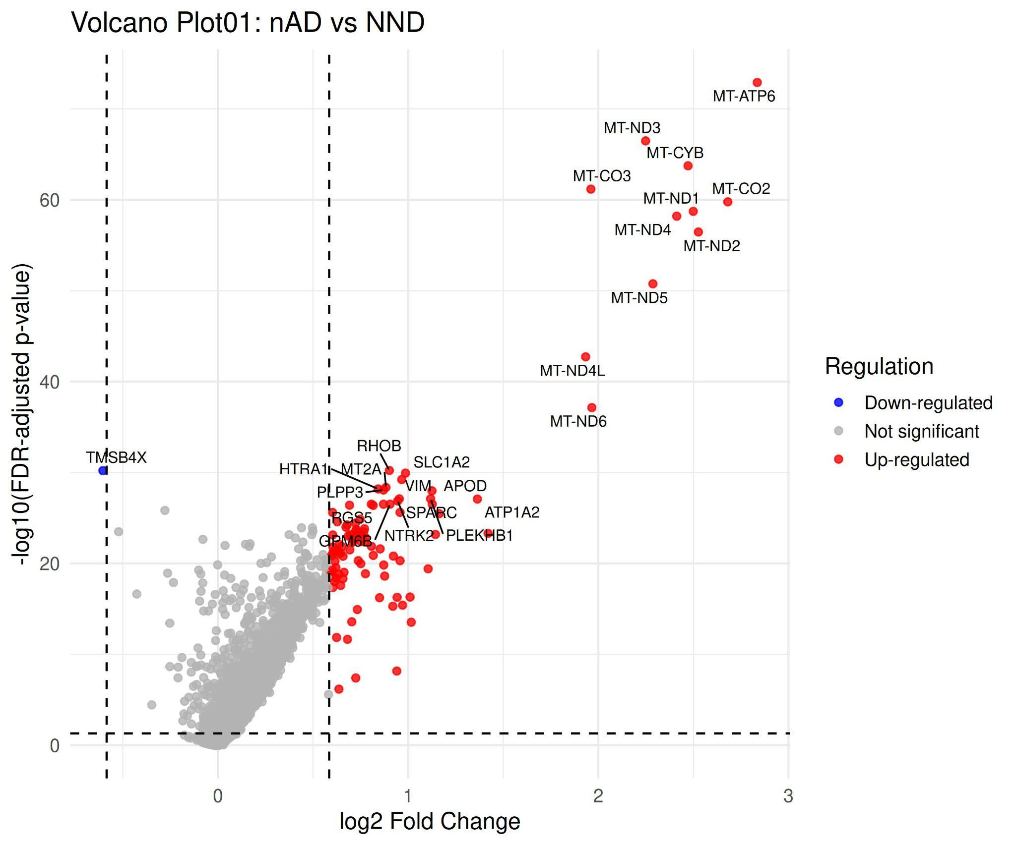
Volcano Plot - nAD vs NND
Notes:
In the nAD vs NND comparison, I see a strong mitochondrial signature.
Most up-regulated genes in nAD are mitochondrial- MT-ND1, MT-ND2, MT-ND3, MT-ND4, MT-CYB, MT-CO2, MT-ATP6, all showing high fold-change and very low FDR.
This indicates increased mitochondrial activity or metabolic stress in nAD microglia.
On the down-regulated side, very few genes pass the cutoff. TMSB4X is the main significantly reduced gene in nAD.
So overall, the major signal is mitochondrial up-regulation specifically in nAD microglia.
Compared to healthy NND controls, nAD microglia show this stress signature, indicating disease-related metabolic dysfunction

Slide 21
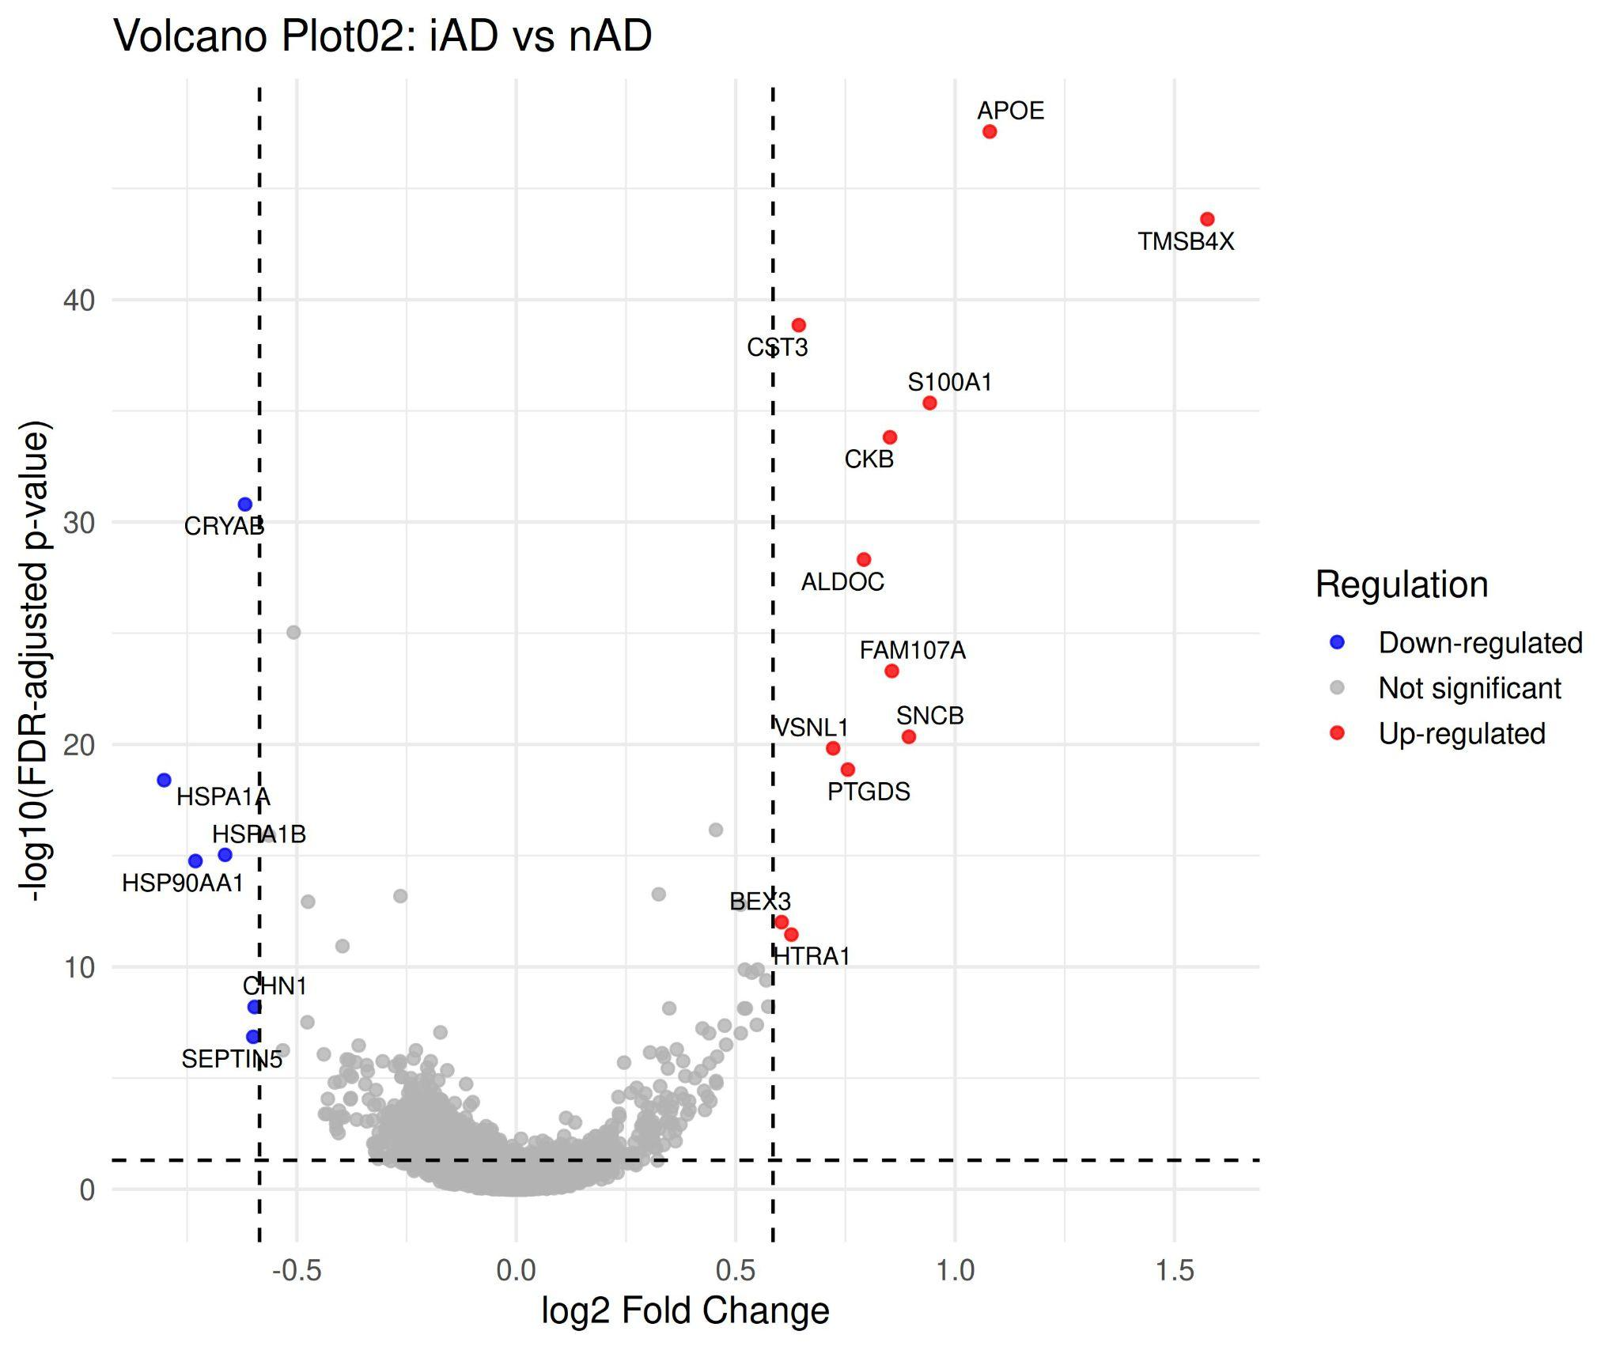
Volcano plot - iAD vs nAD
Notes:
Immunized AD microglia (iAD) show restored neuroprotective function compared to non-immunized AD. Protective genes like APOE, TMSB4X, and CST3 are up-regulated (right side), while stress-response genes like HSPA1A and HSP90AA1 are down-regulated (left side). This shift away from metabolic stress toward neuroprotection demonstrates that amyloid-β immunization successfully restores microglial homeostasis.

Slide 22
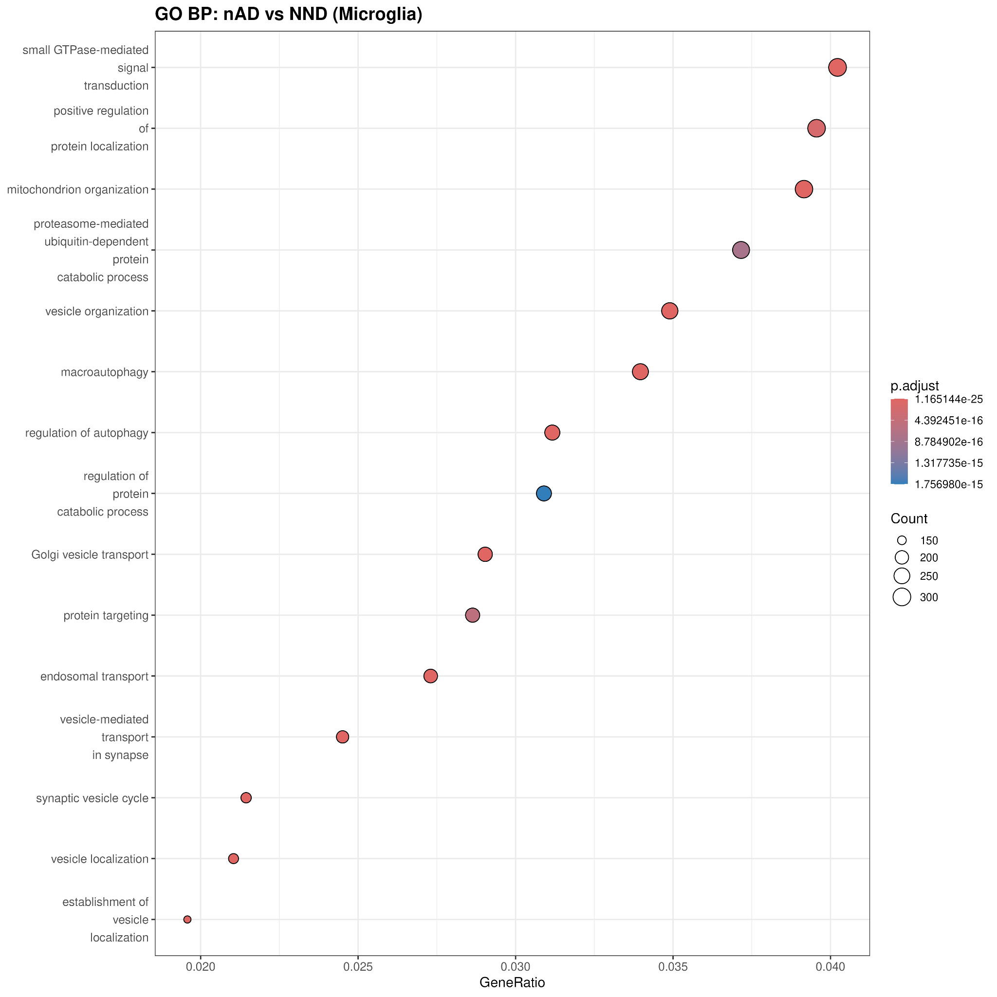
GO Enrichment- nAD vs NND
.
Notes:
nAD microglia are very active in stress processes. The red dots show pathways that are turned on in nAD. These pathways include mitochondrial organization, ATP metabolic processes, and macroautophagy. What this means is that nAD cells are working hard to handle damage and make energy, a sign they are stressed. The blue dots show that normal, healthy homeostatic pathways are turned off in nAD. This matches what we saw in the volcano plot, untreated AD microglia are metabolically dysfunctional.

Slide 23
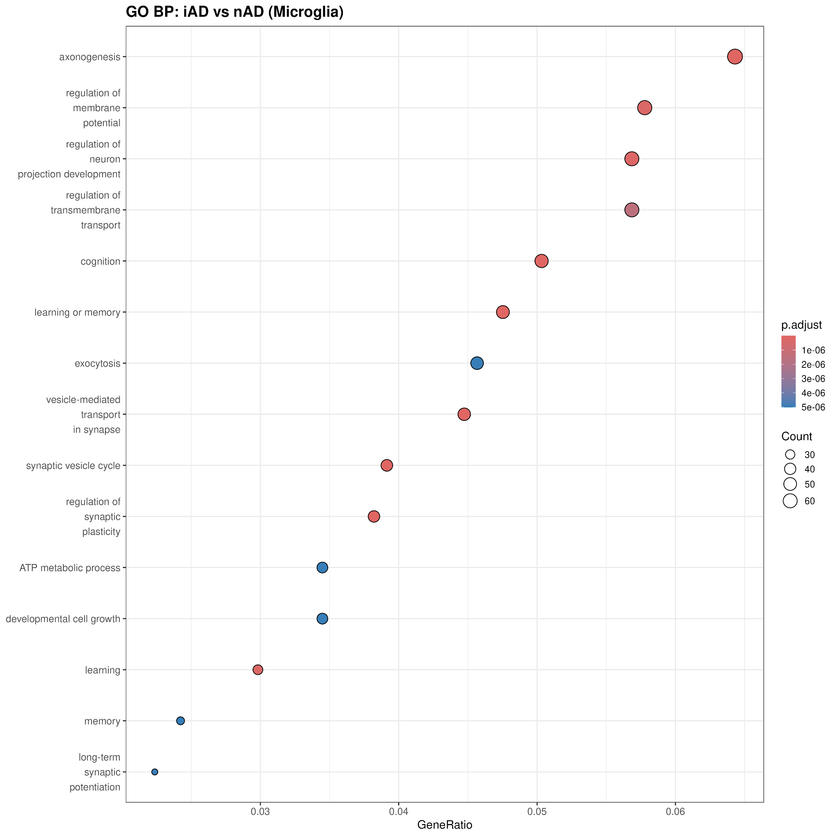
GO Enrichment- iAD vs nAD
.
Notes:
iAD microglia are active in protective pathways instead. The red dots show pathways turned on in iAD, like axonogenesis, neuron projection development, cognition, and synaptic plasticity. These are all things that help neurons stay healthy. The blue dots show that stress response pathways are turned off in iAD. What this tells us is that immunization works, it changes microglia from a disease state to a protective state that supports neuronal health.

Slide 24
Conclusions
nAD microglia show significant metabolic stress and reduced neuroprotective function
iAD microglia show restored protective phenotype with decreased stress markers
Amyloid-β immunization shifts microglial state toward neuroprotection
Results suggest immunotherapy improves microglial health in Alzheimer's disease
Notes:
The data shows a striking difference between immunized and non-immunized AD microglia. Untreated nAD microglia are metabolically stressed and cannot support neurons. In contrast, iAD microglia show recovery of protective pathways and reduced stress responses. This demonstrates that amyloid-β immunization successfully restores microglial function. These findings support the hypothesis that restoring microglial health is a key mechanism of immunotherapy in Alzheimer's disease.

